Slide 1
HW2 Pingpong
H24086032 杜霙笙

Slide 2
Introduction

Slide 3
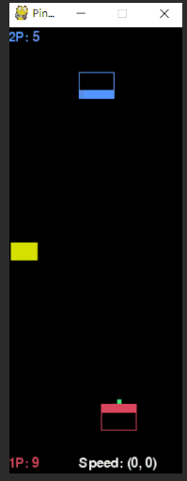
Introduction
Pingpong is a game that involves 2 players. The levels are divided into 3 levels, EASY, NORMAL (includes slicing), and HARD (includes slicing and a blocker).
Observations:
The blocker appears at random .
The ball gains speed after every 100 frames.
It is very hard to predict where the blocker will be.
The platform moves a lot slower than the ball.

Slide 4
Method

Slide 5
Rule
For the EASY and NORMAL level, I simply made a few changes to my arkanoid rule. I read the scene_info then predict where the ball lands.
For the HARD level, I added a block attribute to my mlplay class and variables to predict where the blocker will be and tried two methods:
Slice Ball if the ball is predicted to hit the block, this prevents the ball from hitting the block and makes it easier to catch.
Calculate where the blocker will be and adjust my prediction accordingly.

Slide 6
Rule Result
For EASY and NORMAL the speed was consistently holding its performance at y_speed 22+, with an average of 24 and maxing at 27.
For HARD, the results weren’t as good with an average of 21, maxing at 26 and occasionally dropping to 16.

Slide 7
Features
The features I selected to train my model are:
Coordinates of the ball (ball_x and ball_y)
Platform’s x coordinates of player 1 and 2 respectively
The vectors of x, y and the direction.
The blocker’s x coordinates.
The blocker’s moving direction

Slide 8
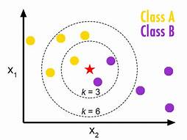
Machine Learning: K-Nearest-Neighbor
I used the Machine Learning model K-Nearest Neighbor.
KNN is a type of supervised learning that uses minimal distance for classification. It is a simple tool for regression analysis. With the KNN algorithm, an algorithm used for classification and regression in statistical analysis, our ML agent will be able to find K nearest neighbors to classify (or label) unknown data.

Slide 9

Machine Learning: Random Forest Classification
I also used the Machine Learning model Random Forest Classification.
Random Forest Classification is a type of multiple decision tree that uses random forests as an ensemble learning method for classification, regression and other tasks that operates by constructing a multitude of decision trees at training time and outputting the class that is the mode of the classification or average prediction of the individual trees.

Slide 10
Discussion

Slide 11
Different Machine Learning models I tried…
K-Nearest Neighbor
SVM
SVC
SVR
LinearSVC
Random Forest Classification

Slide 12
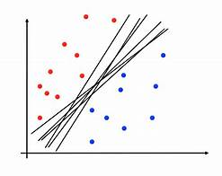
Comparison: SVR
Slow Algorithm
Hard to implement
Model score 75~85
Small pickle file output
Result (personal score):
Training speed: 2/10
Performance: 6/10
Overall: 4/10

Slide 13
Comparison: SVC
Slow Algorithm
Model score 75~85
Small pickle file output
Parameters need experimenting (e.g. ovo, ovr…)
Result:
Training speed: 2/10
Performance: 8/10
Overall: 6/10
Good for small amount of data

Slide 14
Comparison: LinearSVC
Slightly Faster Algorithm than SVC
Model score 75~85
SVC with a Linear kernel
svm.SVC(kernel=‘linear’)
Result:
Not a good fit for the data given

Slide 15
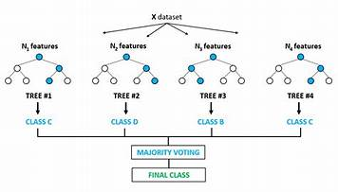
Comparison: RFC
Fast algorithm
Easy to implement
Very large pickle file output
Result:
Training speed: 7/10
Performance: 8/10
Overall: 8/10
Good for large amounts of data

Slide 16
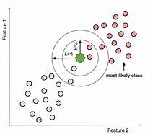
Comparison: KNN
Fast algorithm
Easy to implement
High model score 95+
Medium-sized pickle file output
Result (personal score):
Training speed: 9/10
Performance: 9/10
Overall: 9/10
Good for medium to large amount of data
Steady

Slide 17
Different Features
ballx, bally, and platform = terrible results
ballx, bally, x_speed, y_speed, direction, and platform = bad results
ballx, bally, x_speed, y_speed, blocker, and platform = not so good results
ballx, bally, x_speed, y_speed, blocker, blocker_speed, and platform = acceptable results
ballx, bally, y_speed, direction, blocker, blocker_speed, and platform = good results
ballx, bally, x_speed, y_speed, direction, blocker, blocker_speed, and platform = best results

Slide 18
Different Data
No data Pruning = a lot of error = terrible results
Pruned data = less error = good results
E.g. taking out command = serve and moving before ball is served…
Quantity:
Affects the model TREMENDOUSLY!!!!!!!!!!
The more the better, but too much results in long computation time, large pickle file output, and possibly overfitting.

Slide 19
Other
KNN was the machine learning method I used for both arkanoid and pingpong.
While training, I discussed with my friend and searched the web for many different machine learning models to train our agents and realized that Random Forest Classification yielded good results as well.
(Maybe it could be considered to be added to the curriculum under decision tree?)

